Slide 1
Large array readout using address event representation

Slide 2
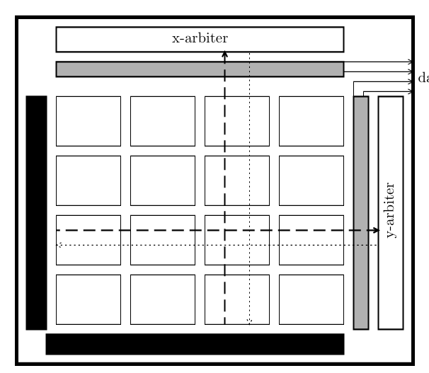
Neuromorphic Vision
Limitations of Frame-Based Readout
Every pixel is sampled every frame.
Power scales with total number of pixels.
Large data bandwidth even for sparse scenes.
Biological vision transmits changes instead of complete frames.
Most pixels are inactive at any instant.
Reading every pixel wastes bandwidth and power.
AER communicates only active neuron events.

Slide 3
Address Event Representation (AER)
Each neuron has a unique digital address.
When a neuron spikes, it requests the shared communication bus.
An arbiter resolves simultaneous requests.
Only the address is transmitted to the receiver.
light
Photodetector array
Pixel Spike Generation
2D Arbiter (Row + Column)
Reset Pixel
Receiver (Ack signal)
Address Encoder

Slide 4
Two-Dimensional AER
Pixels arranged in rows and columns.
Vertical arbiter selects a row.
Horizontal arbiter selects a column within that row.
(Row, Column) uniquely identifies the active neuron.
Arbiter Architecture
R1,R2,R3
1) Request Generation 2) Steering Network 3) Choosing (Winner Selection)
↓
Competition
↓
Winner
↓
Address

Slide 5
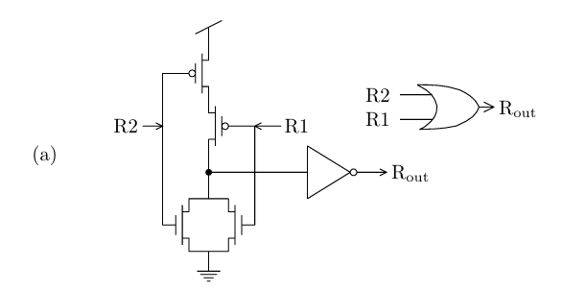
Request generating circuit
The photodetector converts light into a photocurrent.
The pixel integrates this current.
Once the voltage reaches the threshold, the neuron fires. The neuron produces a request signal indicating that it wants to send its address.

Slide 6
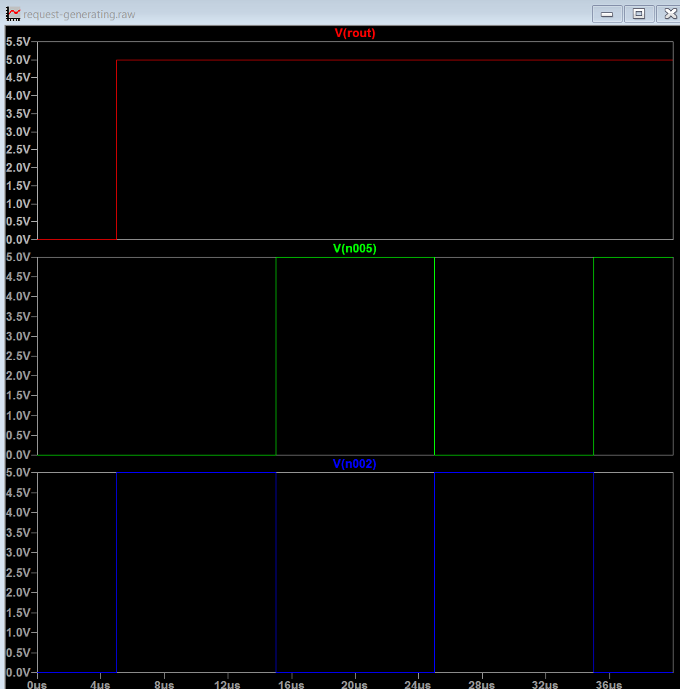
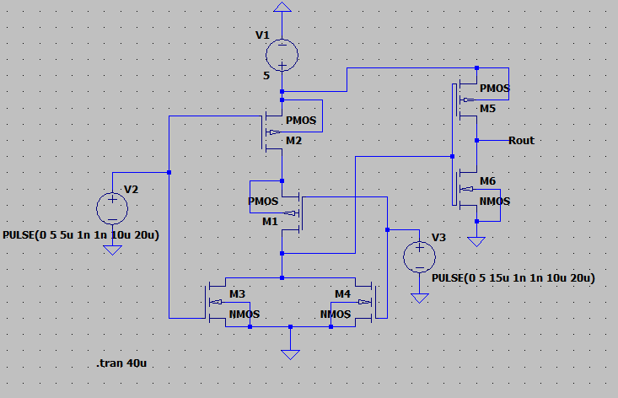

Slide 7
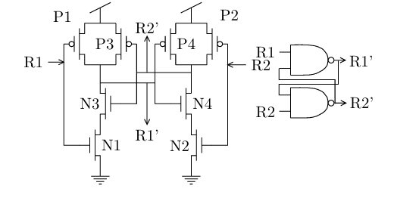
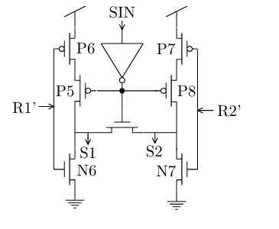
Steering circuit and Choosing circuit
This part of the circuit prevents contention between multiple requests If multiple requests occur at the same time it resolves simultaneous requests using positive feedback. Multiple neurons may request the communication bus at nearly the same time, the circuit ensures that only one request wins while all others wait until the next arbitration cycle

Slide 8
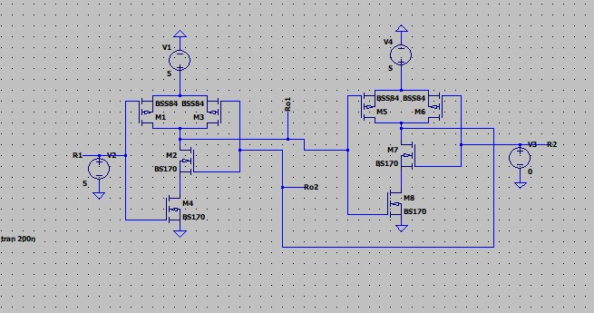
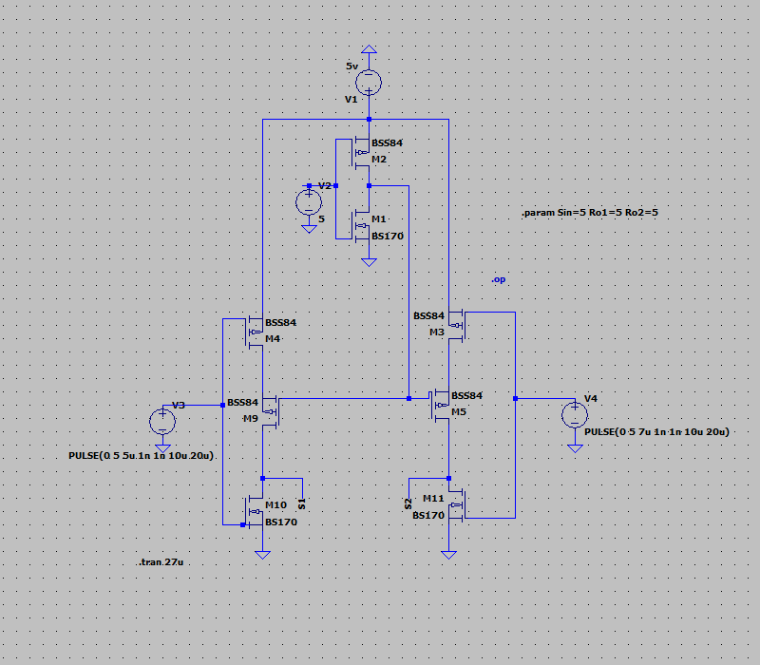

Slide 9
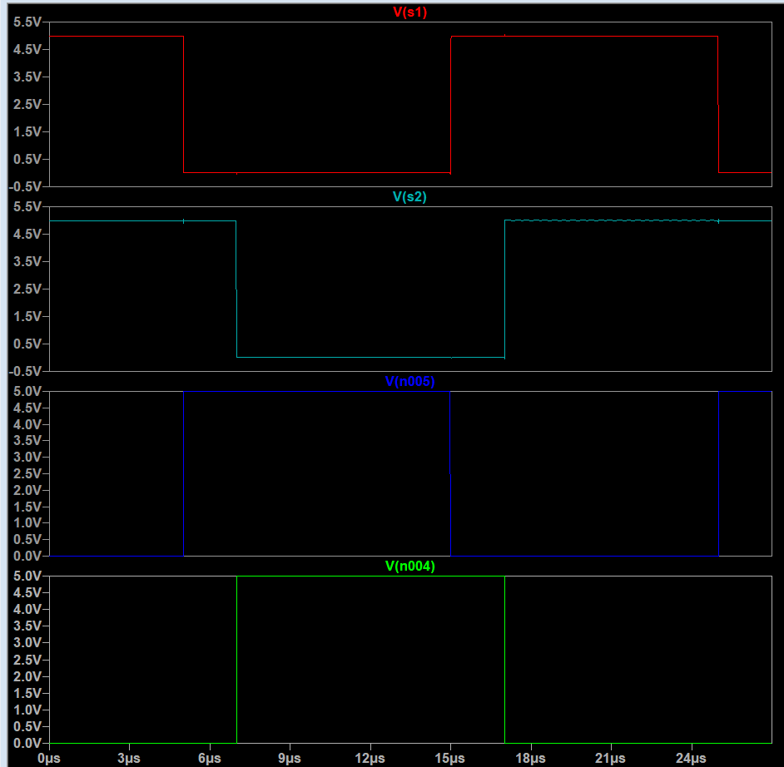
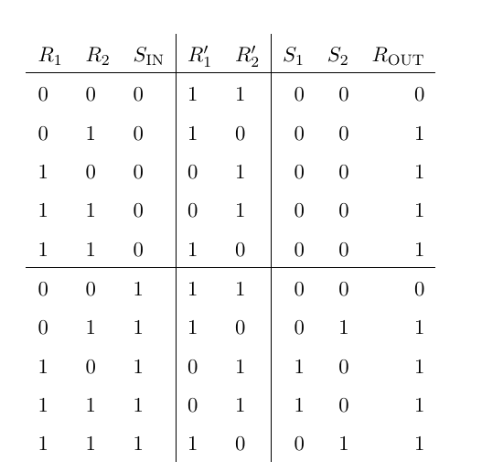
Output of choosing and the steering ckt

Slide 10
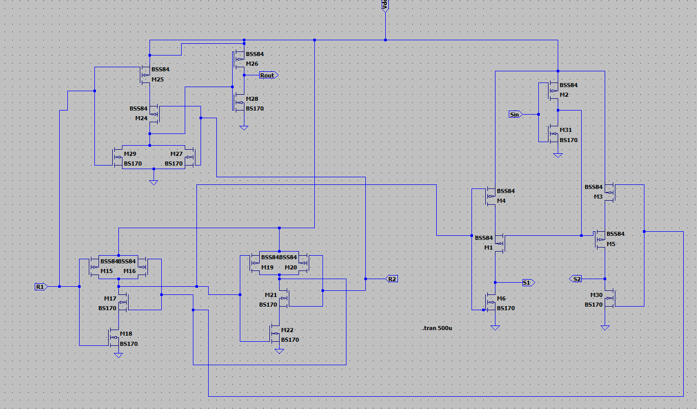
2 INPUT ARBITER

Slide 11
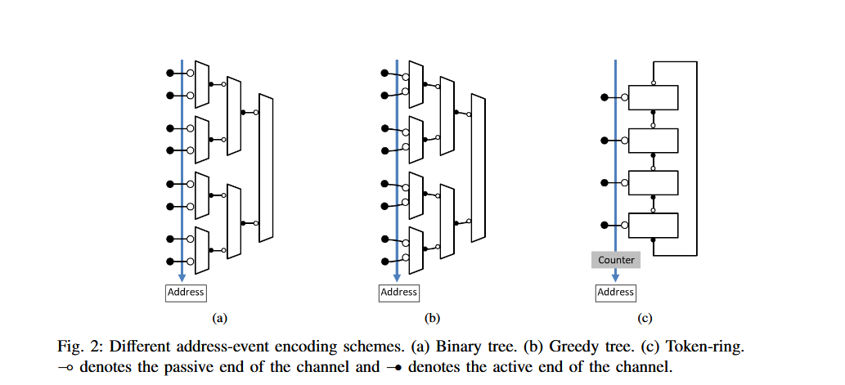
Arbiter structures for multiple inputs
Here we implemented the binary tree structure as Uses only small, identical 2-input arbiter cells, making the design modular
Scales naturally to larger arrays by adding more levels to the tree

Slide 12
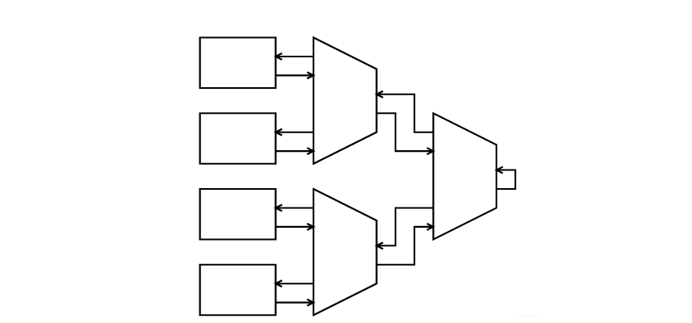
The Arbiter is a binary tree of two-input arbitration cells. Each cell receives two requests from below and an Acknowledge from above. It transmits a request to the higher level of the tree and passes down two Acknowledge signals
The total delay through the Arbiter is proportional to log(N) Forward phase of the data transfer cycle, the requests propagate from the lowest level of the tree to the top then the select propagates from the top to the bottom of the tree
When the select propagates back to the bottom level of the tree, the selected neuron address is placed on the data bus

Slide 13
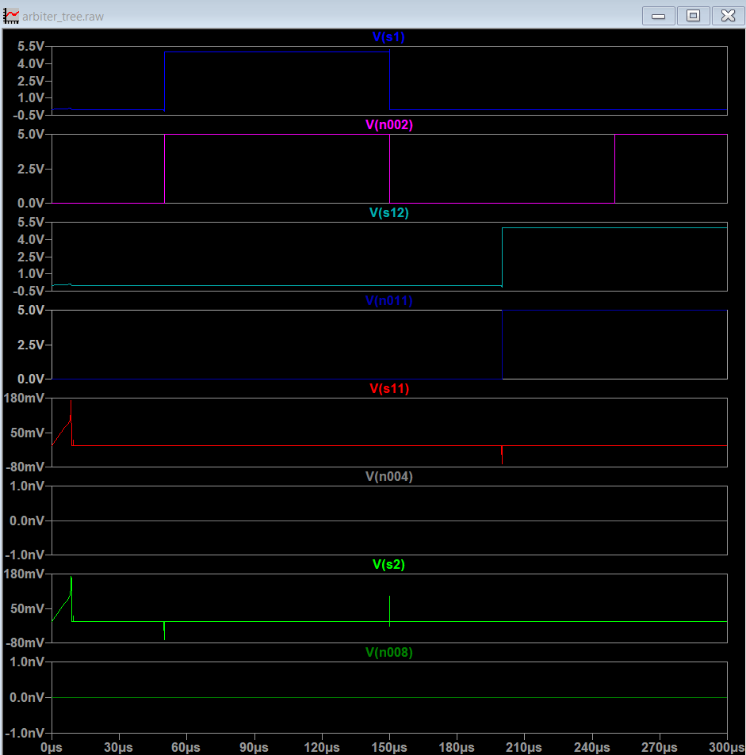
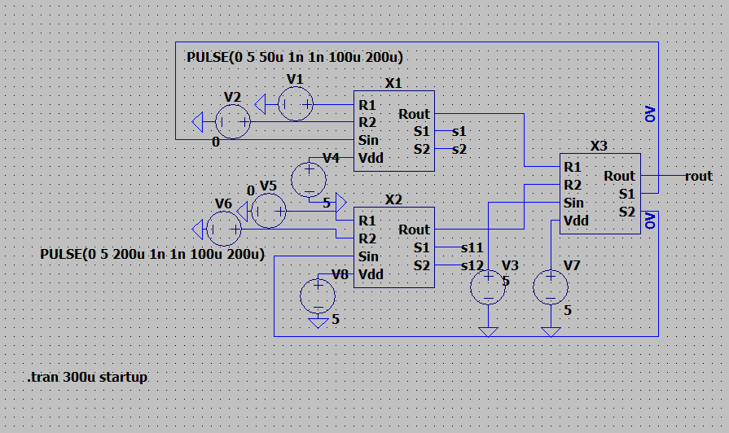

Slide 14
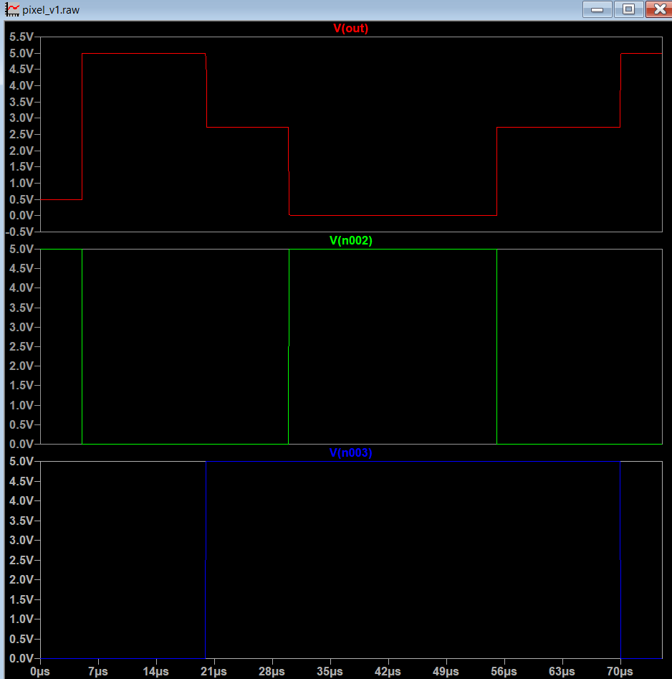
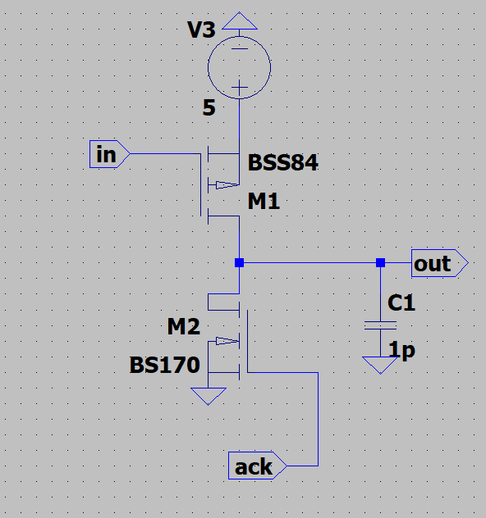
Signal generation
Input is generated by a comparator and the resulting pulse is stored in a capacitor before being sent to arbiter.
Once the pixel address is transmitted the ack signal is generated which resets the pixel

Slide 15
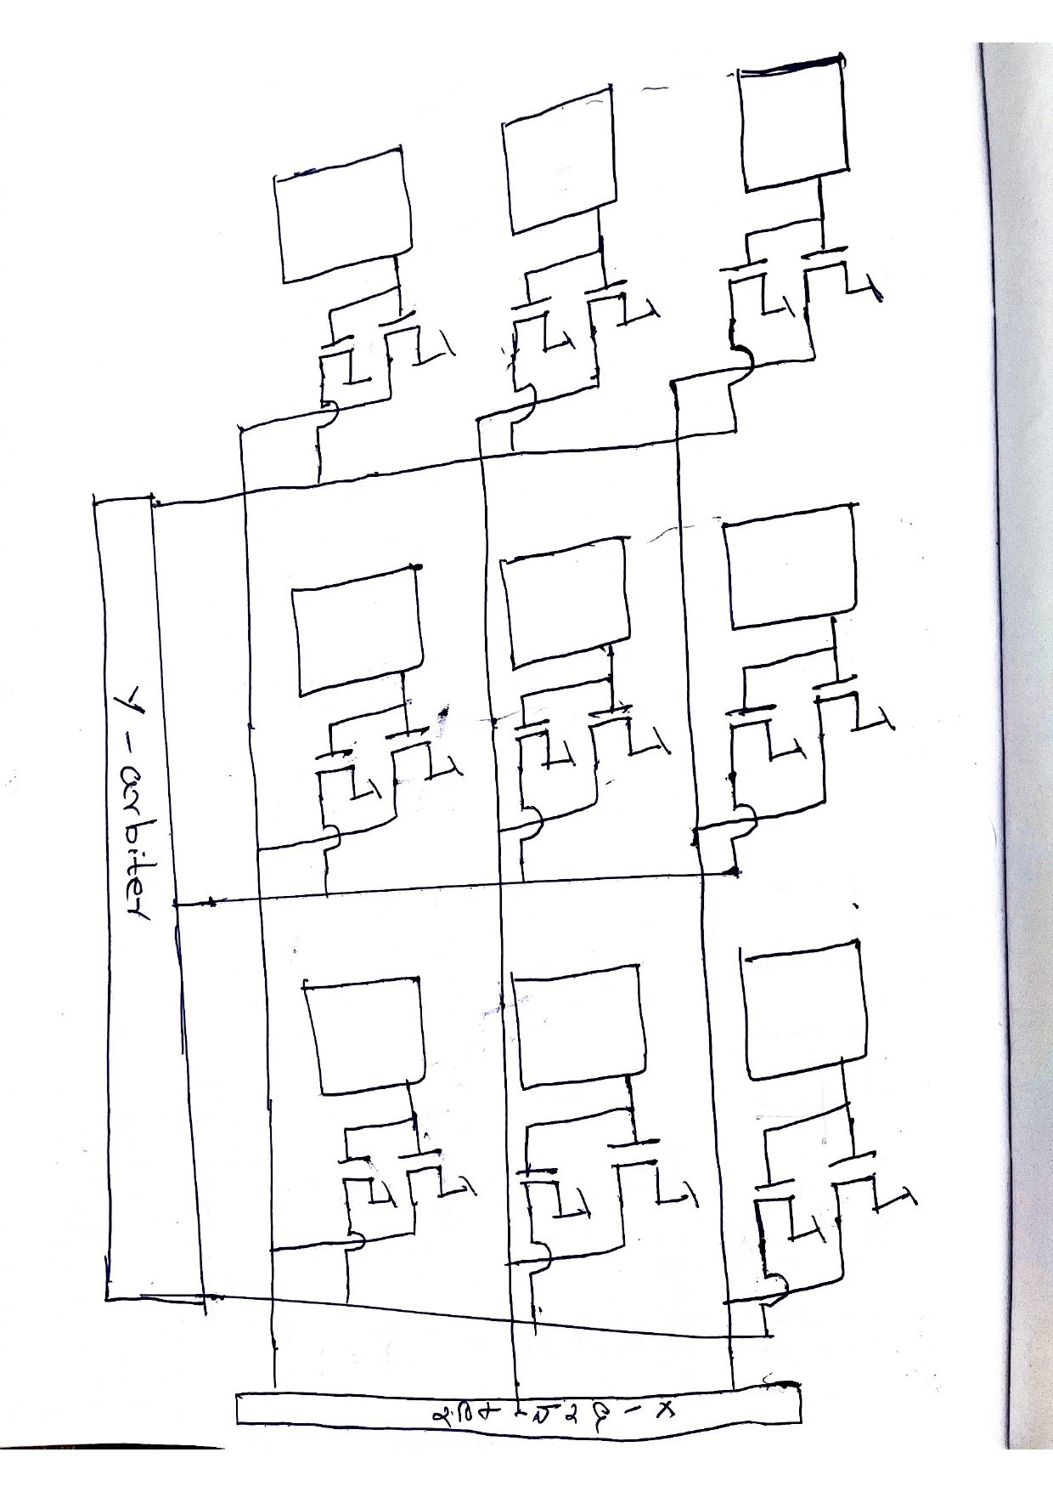
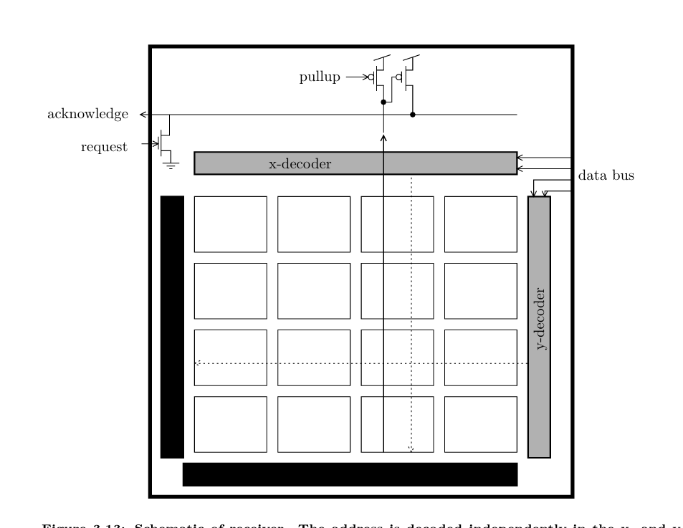
Array readout (In progress)
Pixels arranged in rows and columns.
Vertical arbiter selects a row.
Horizontal arbiter selects a column within that row.
(Row, Column) uniquely identifies the active neuron.
The address of the selected pixel is transmitted and the ack signal is generated
So far the arbiter is able to identify the pixel that generates the pulse but the address generation and the generation of ACK reset of that pixel has not been completed

Slide 16
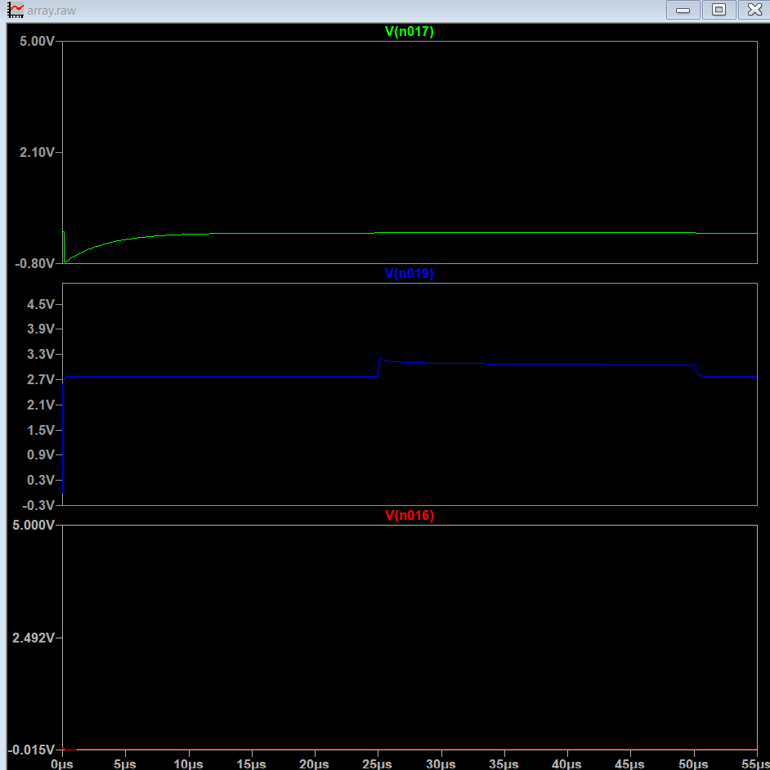
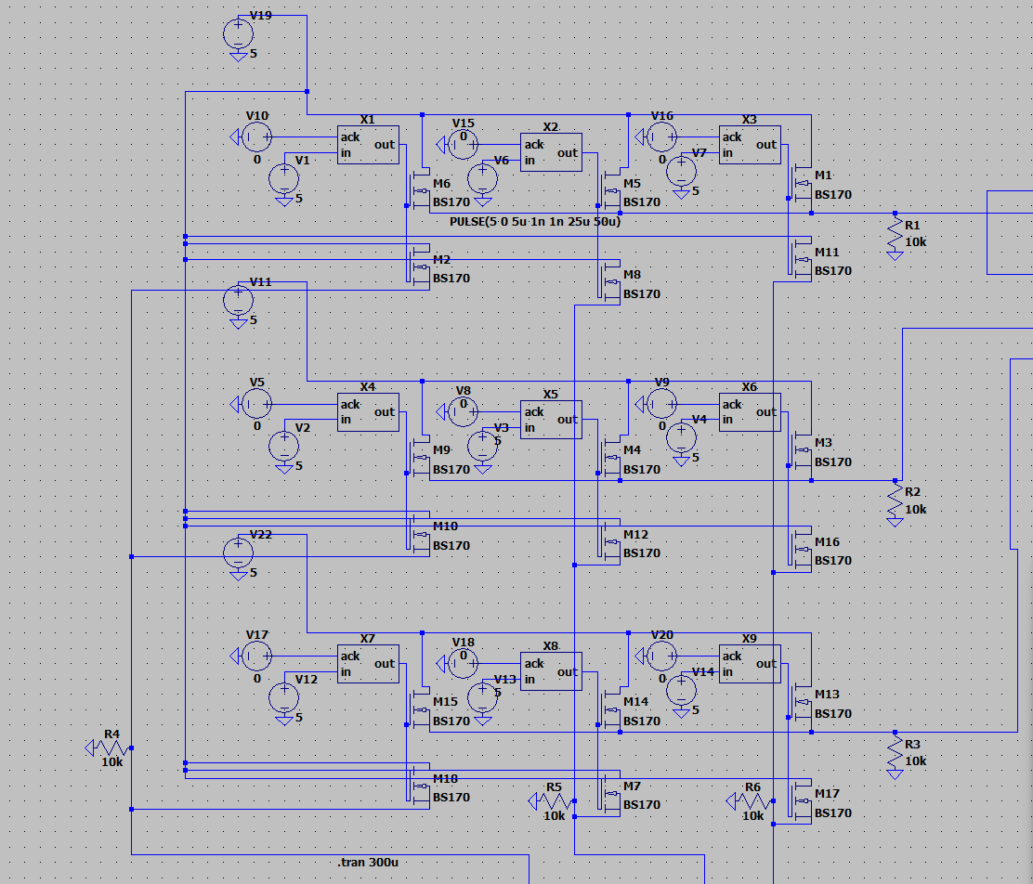
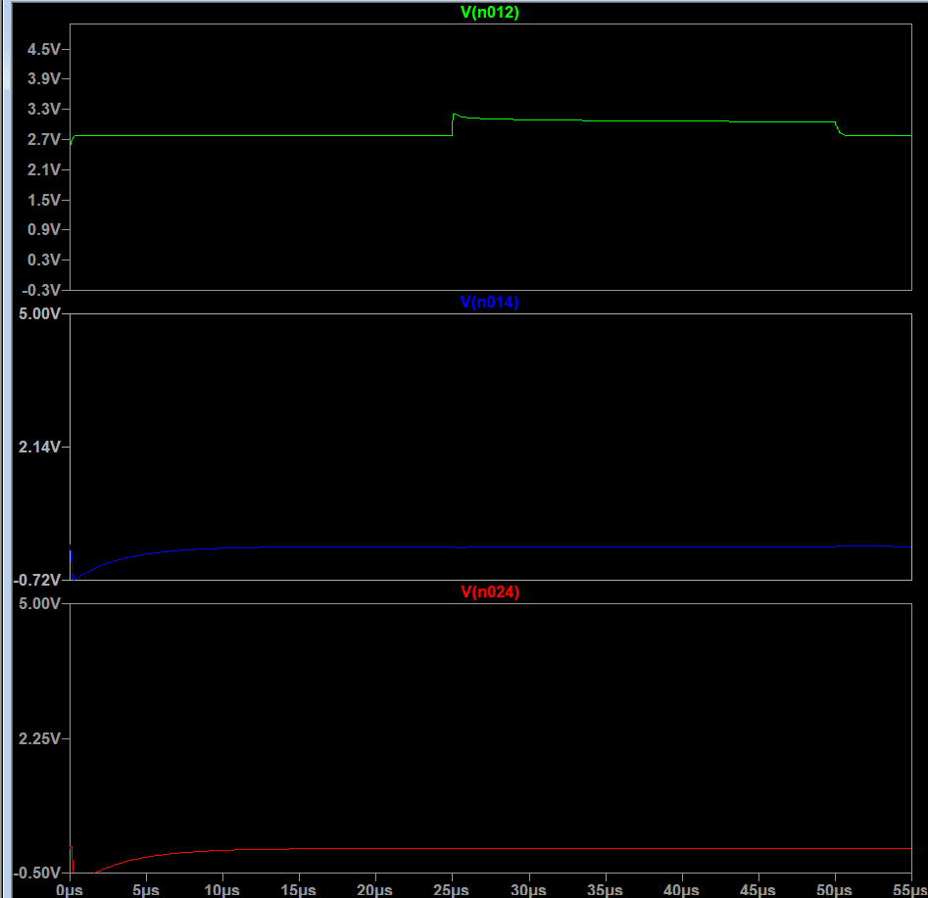
Col select lines
Row select lines

Slide 17
Current progress
Literature Review
Pixel circuit
2-input arbiter
Arbiter tree
Integration of row and col arbiter to 3*3 sensor array
To Do
Address generation
Ack signal generation and reset circuit

Slide 18
References
VLSI Analogs of Neuronal Visual Processing: A Synthesis of Form and Function - Misha Mahowald
Point-to-Point Connectivity Between Neuromorphic Chips using Address-Events - Kwabena A. Boahen
A 128×128 120dB 15us Latency Asynchronous Temporal Contrast Vision Sensor - Patrick Lichtsteiner, Christoph Posch, and Tobi Delbruck
Analog VLSI: Circuits and Principles By Shih-Chii Liu, Jörg Kramer, Giacomo Indiveri, Tobias Delbrück, and Rodney Douglas.

